Slide 1
DOM105 2019
Session 24
Reading: Kothari ch. 10, 11

Slide 2
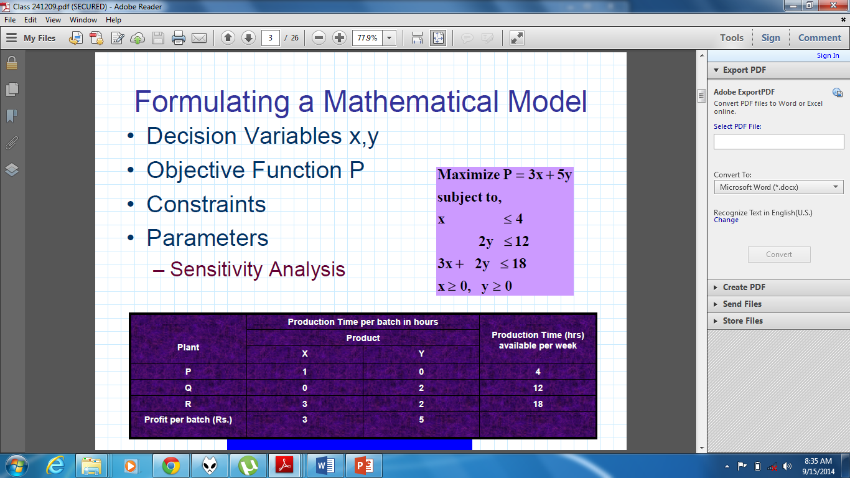

Slide 3
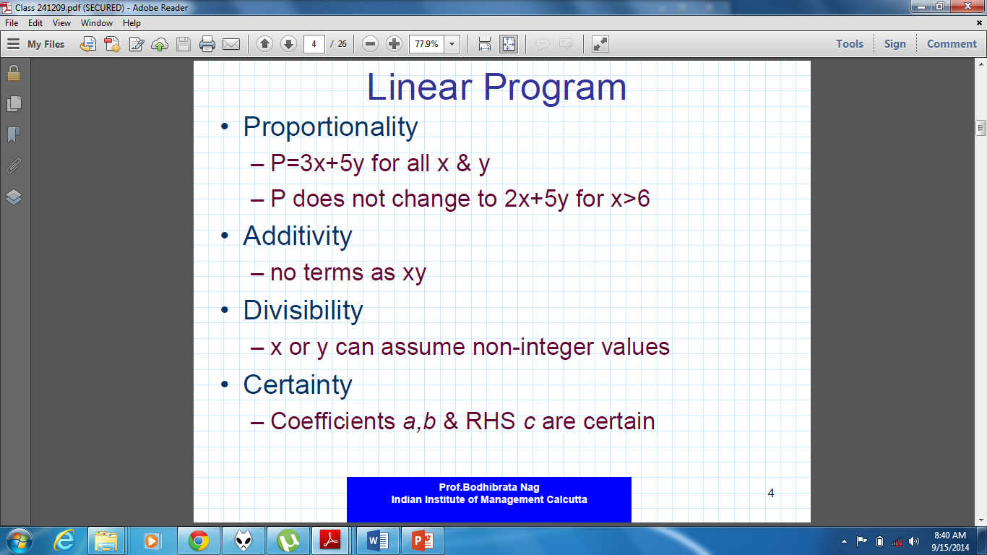

Slide 4
Solving LP problems in Excel
LP Problems can be solved in Excel using the Solver tool under the “Data” tab.
First, set up the linear programming equations and constraints using the information given in a problem, then implement those equations in Excel before solving them.
Excel Solver gives the option of using Simplex method to solve the problem.

Slide 5
Shadow price (Found in Sensitivity report of Excel Solver):
Increasing the RHS of any constraint by 1 will increase the optimum value by the shadow price of that constraint (or decrease if shadow price is negative)
Allowable increase/decrease:
Represents the range of values by which a constraint RHS can be increased or decreased, without affecting the optimality equation. Within the allowable range, a change to the constraint RHS will change the optimal value by the shadow price * amount of change.

Slide 6
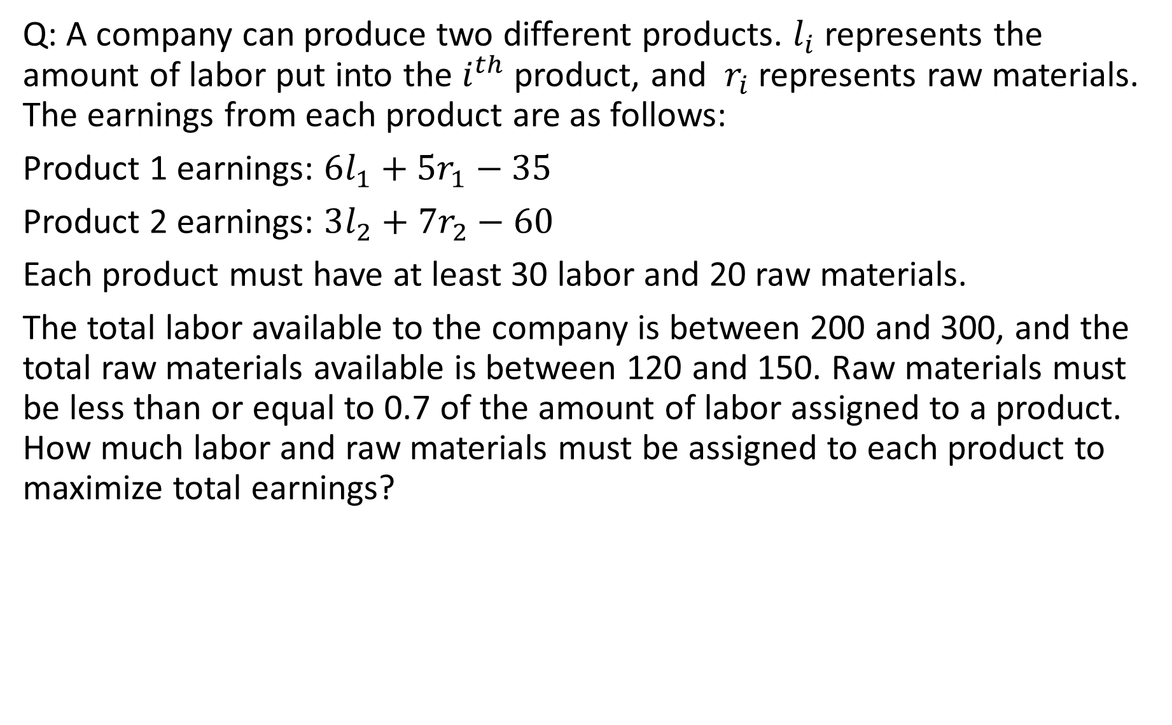
Q: A company can produce two different products. $l_{i}$ represents the amount of labor put into the $i^{th}$ product, and $r_{i}$ represents raw materials. The earnings from each product are as follows:
Product 1 earnings: $6l_{1}+{5r}_{1}−35$
Product 2 earnings: $3l_{2}+{7r}_{2}−60$
Each product must have at least 30 labor and 20 raw materials.
The total labor available to the company is between 200 and 300, and the total raw materials available is between 120 and 150. Raw materials must be less than or equal to 0.7 of the amount of labor assigned to a product. How much labor and raw materials must be assigned to each product to maximize total earnings?

